Slide 1
Java Based Frameworks
Dr. Archana B Saxena, Professor, Department of IT
archanabsaxena@gmail.com, archanab.saxena@gmail.com

Slide 2
Java Base framework: Hibernate [A JPA implementation framework]
Hibernate is an Object-Relational Mapping (ORM) framework for Java that simplifies database interactions by allowing developers to work with Java objects rather than SQL queries. It provides a way to map Java classes to database tables and supports various database operations through a clean and encapsulated API, making data manipulation easier and reducing boilerplate code.

Slide 3
JPA Jakarta Persistence API /(Java Persistence API)
JPA is just a specification that facilitates object-relational mapping to manage relational data in java application. It provides a platform to work directly with objects instead of SQL statements.
JPI implementations are:
Hibernate
EclipseLink
TopLink
MyBatis

Slide 4
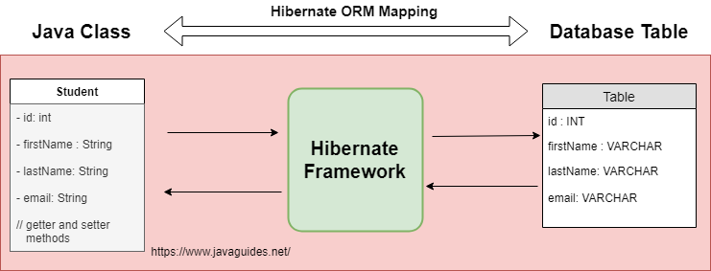
Example: The diagram below shows an ORM (Object-Relational Mapping) tool between the
Student Java class and the student's table in the database.

Slide 5
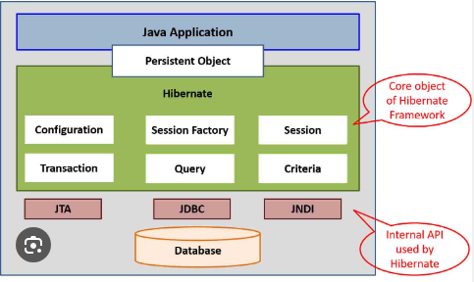
- JDBC(Java Database Connectivity)
- JTA (Java Transaction API) handles transaction across multiple resources in a distributed environment.
JNDI (Java Naming and Directory Interface ): it is used to configure data source in your application.

Slide 6
Spring Framework

Slide 7
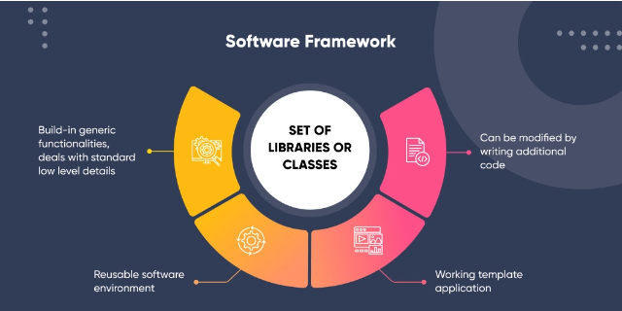
What is a framework?
A framework is a layered structure that provides reusable software components for building applications. It allows you to build various programs using templates and tools and correlate them without starting from the scratch.

Slide 8
Libraries Vs frameworks Difference lies in usage and structures of libraries and frameworks
Frameworks
Framework offers comprehensive solutions for large applications that includes structures and guidelines for building applications.
It dictates the flow of control how different components will interact with one another.
Framework contains API’s , compilers and tools
Libraries
Library comprises collection of reusable code that developer can call to perform specific task.
Libraries provide functionality that can be reused.

Slide 9
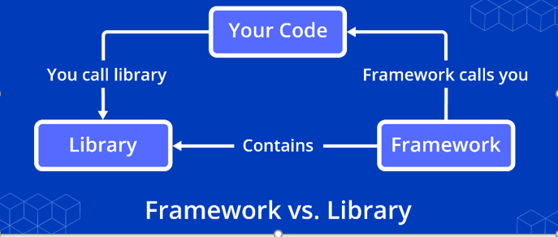
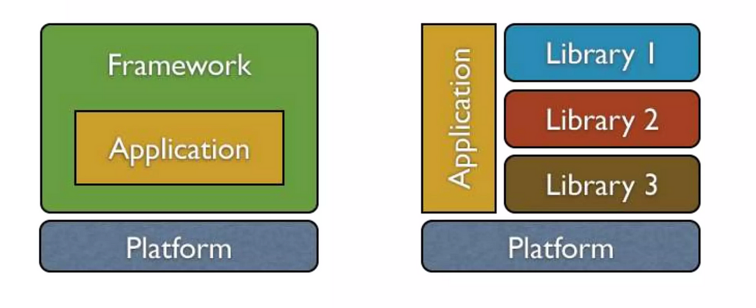

Slide 10
Libraries Vs API’s
API(Application Programing Interface)
An API is an Application Programming Interface. It is a set of clearly defined methods of communication between different software components.
Example: Google GPS API/Location API
Library
A library is a collection of already written code that can be used to perform various tasks.
An API may provide the functionality to a library.
Example : C++ STL (Standard Template Library)

Slide 11
Types of framework
Web application development framework
Django is a python based framework.
Express is backend web application framework
Ruby on rails is server side web application framework
Angular is type script based web application framework
Laravel is a php framework for building web application
Data science frameworks
TensorFlow is a free and open-source software library for machine learning and artificial intelligence
NumPy is a library for the Python programming language,
Mobile application Development frameworks
React Native
Jquery Mobile
Flutter
Ionic
Content management framework

Slide 12
Enterprise level application is a large –scale software solution designed to operate in a corporate environment ex: business/ government
These applications are sophisticated and aims to streamline and automate various processes with organization to complete complex operations.
Java EE (Enterprise Edition) is a set of specifications that provide a standard for developing enterprise level application.
Java EE uses various technologies:
Servlets
JSP (Java Server Pages)
Enterprise Java Beans
Java EE is very good but complex and heavy, to solve these issues Spring framework was introduced in 2003.

